Slide 1

Monthly Market Mantra
April, 2026
Monthly Market Update March, 2026

Slide 2
Market Overview
India
RBI keeps repo rate unchanged in Apr-26, maintains neutral stance
RBI’s $100mn NOP cap unwinds $15–40bn arb, lifting INR
India’s ~85% crude import dependence risks widening CAD ($13.2bn, 1.3% GDP) amid Middle East tensions
Other International Market
US President Trump proposes 100% tariffs on pharma imports
ECB and BOJ hold rates amid inflation and geopolitical risks
Energy shocks emerging as key macro risk across South Asia economies
U.S.
US Fed keeps rate holds interest rates, signals delayed cuts amid inflation and geopolitical risks
US unemployment rate holds steady at 4.3% in Mar-26
US 10-year Treasury note rose to around 4.37% in Mar-26 amid escalations in US – Iran war
International
Gold eases to ~ $4,600 / oz amid escalating West Asia tensions
Brent crude ~$ 100/bbl reflects tight supply and elevated global risk
Global markets remain cautious amid rising commodity prices and geopolitical uncertainty
Source: Moneycontrol, Bloomberg, CNBC, Trading economics
As on 8thApril 2026
www.shriramamc.in

Slide 3
Indian markets see sharp correction in Mar-26
All indices in red in 1M period
Broad based correction across indices over 3M & 6M period
Disclaimer: Past performance may or may not sustain in the future
Data Source: NiftyIndices.com
Data as on 30th March, 2026
www.shriramamc.in

Slide 4
Global Markets (MSCI) – Geopolitical Impact
Global markets came under significant pressure as escalating Middle East tensions sent oil prices sharply higher, undermining investor confidence and triggering a broad-based selloff across equities in Mar-26
Disclaimer: Past performance may or may not sustain in the future
Data Source: MSCI.com
India data as on 30th March 26, Rest of the world data as on 31st March 2026
www.shriramamc.in

Slide 5
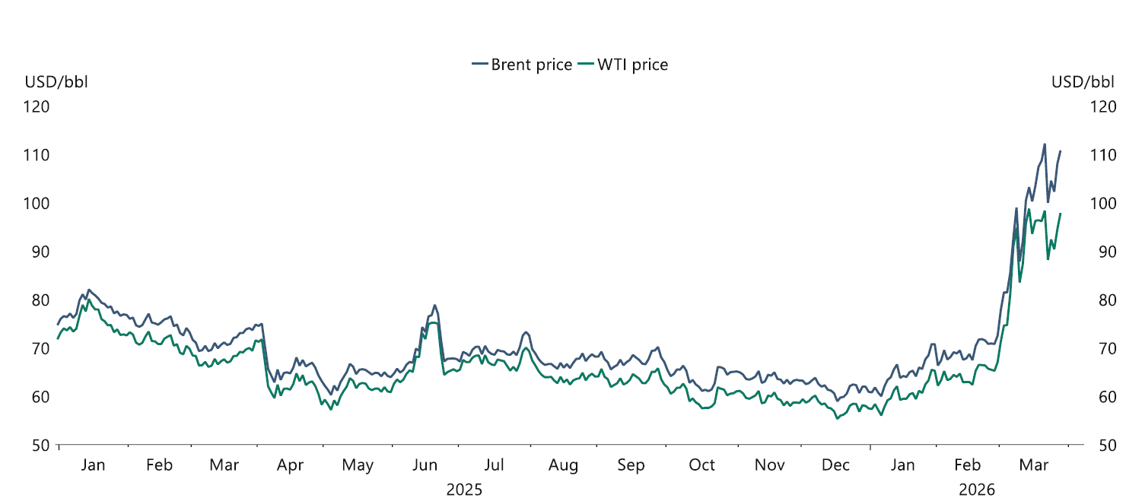
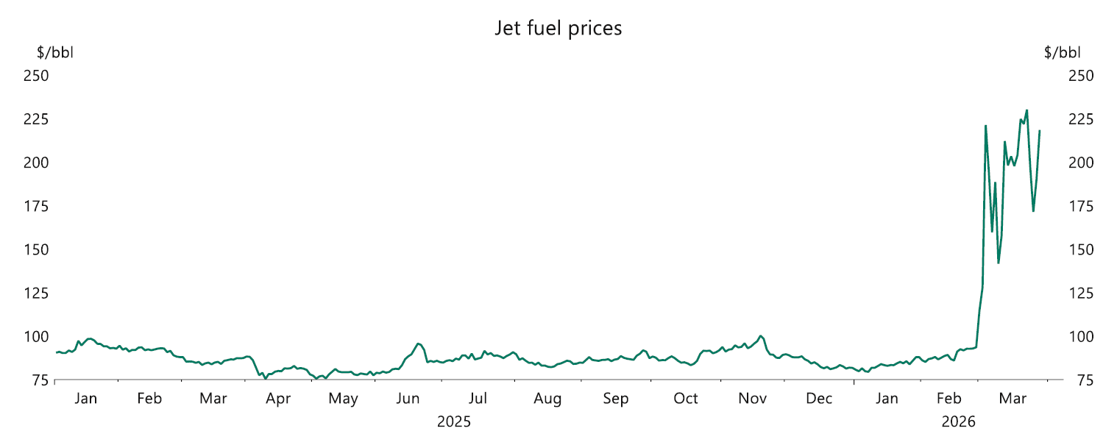
Energy prices continue to rise in Mar-26……
Brent Crude & WTI prices > $105/ bbl levels
Jet fuel prices spike >$200/bbl levels
Source: Apollo global management research
Brent Crude & Jet fuel data as on 31st March,2026
www.shriramamc.in

Slide 6
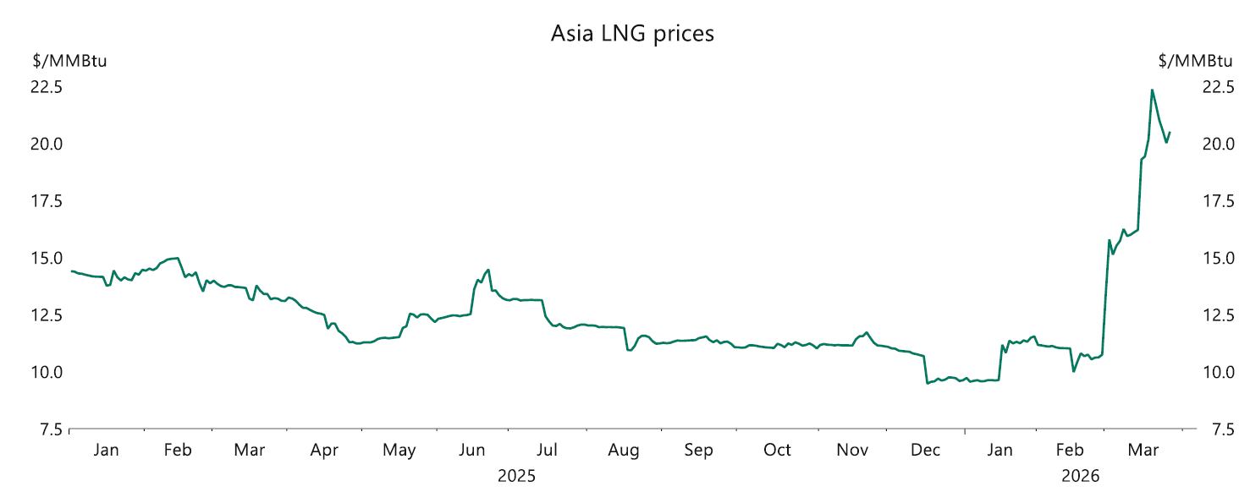
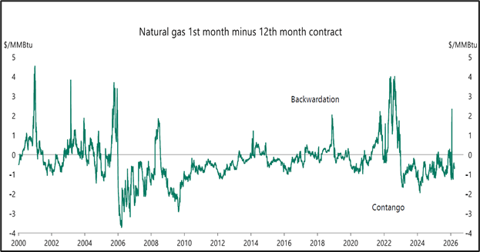
…..LNG and Natural gas prices elevate in Mar-26
Aisa LNG prices have sharply surged from $10.75/MMBtu to >$20/MMBtu
Natural gas futures in contango, trading above $2.75/MMBtu
Source: Apollo global management research
LNG & natural gas prices data as on 31st March,2026
www.shriramamc.in

Slide 7
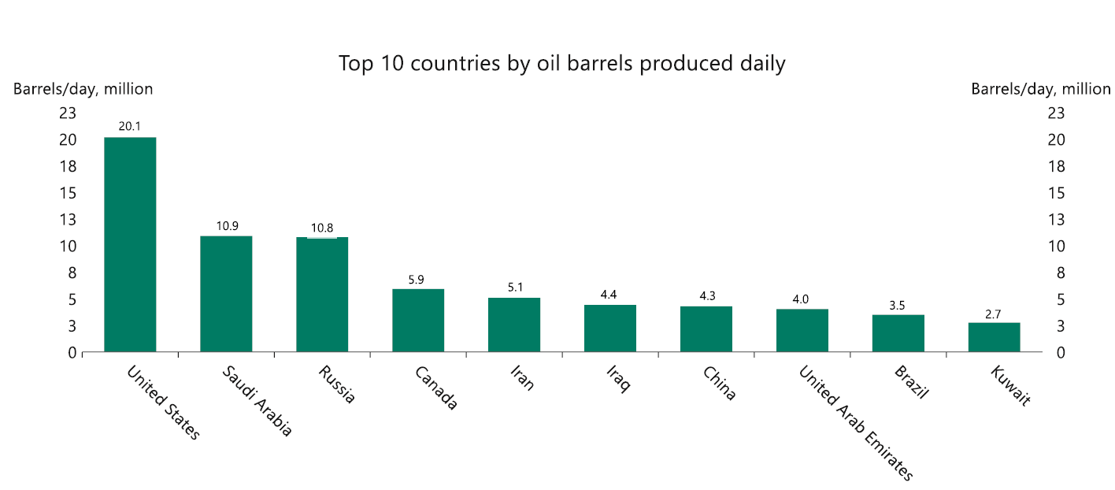
Global oil production leader
US, Saudi Arabia & Russia are the largest oil producers globally
Source: Apollo global management research
www.shriramamc.in

Slide 8
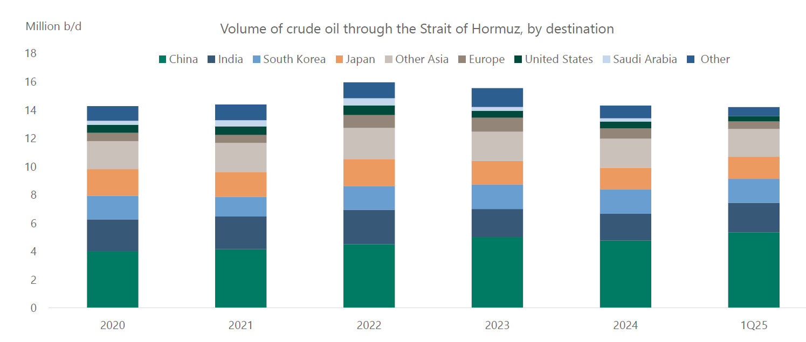
Hormuz plays a vital role
Hormuz carries ~20% of global oil flows, underscoring its strategic significance
Source: Apollo global management research
www.shriramamc.in

Slide 9
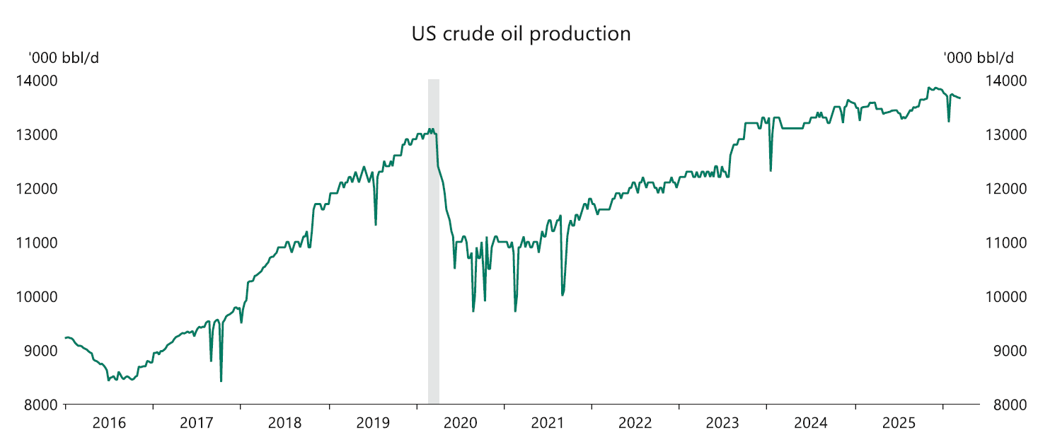
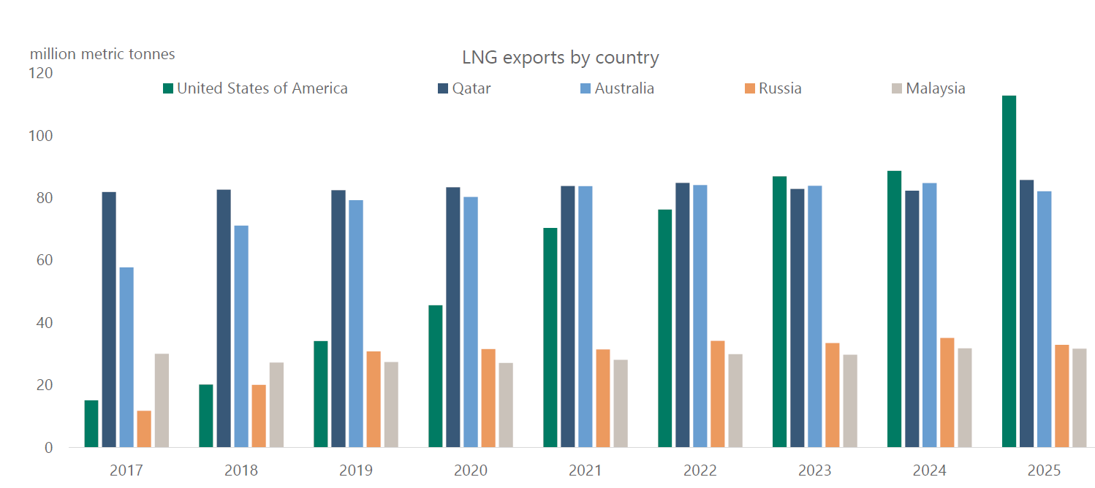
US energy resilience through supply strength
US oil production highest in CY2025
US is the key exporter of LNG
Source: Apollo global management research
www.shriramamc.in

Slide 10
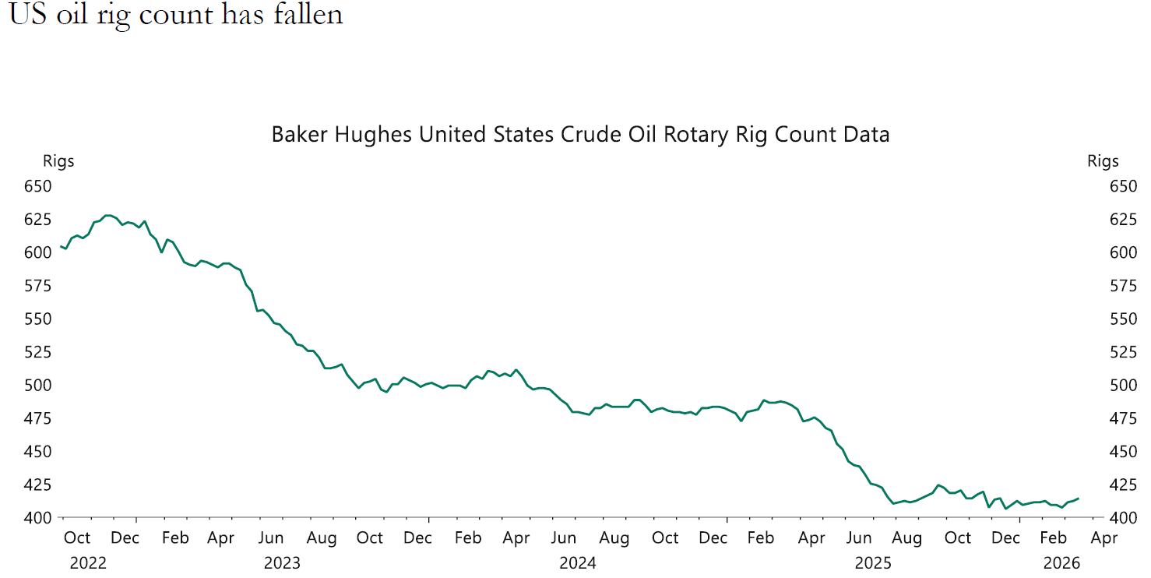
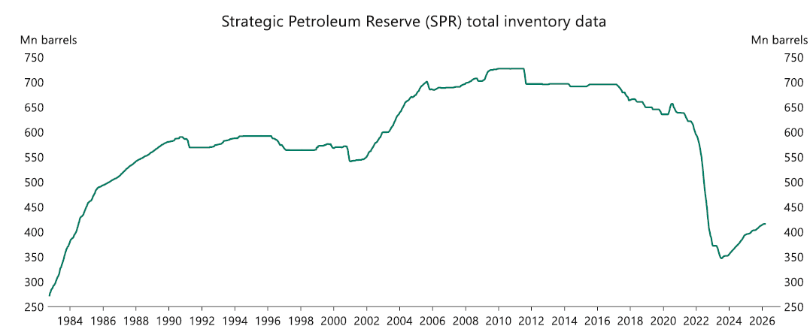
US energy support weakening?
US oil rig count has fallen
US SPR inventory at low levels
Source: Apollo global management research
www.shriramamc.in

Slide 11
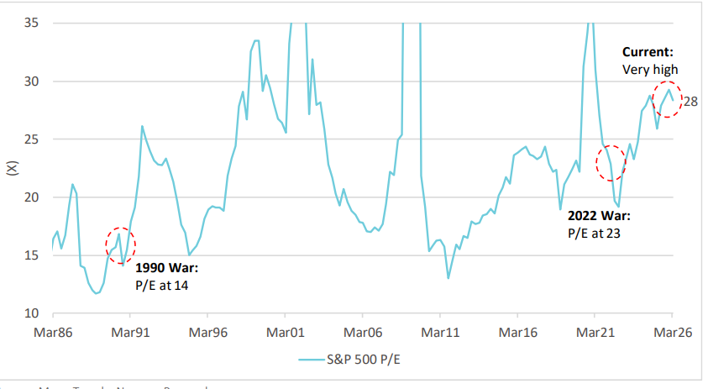
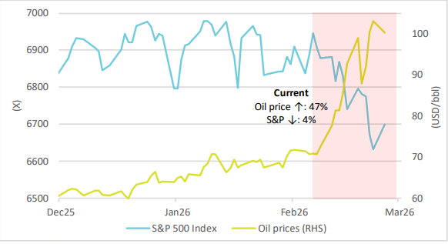
US equity markets vulnerable?
S&P 500 P/E
S&P 500 Index & Oil prices
S&P 500 is currently trading at valuations higher than during previous conflict periods in 1990 and 2022
S&P 500 remains resilient so far, correcting ~4% despite a sharp ~47% rise in oil prices
Source: Nuvama research, data as on 23rd Mar-26
www.shriramamc.in

Slide 12
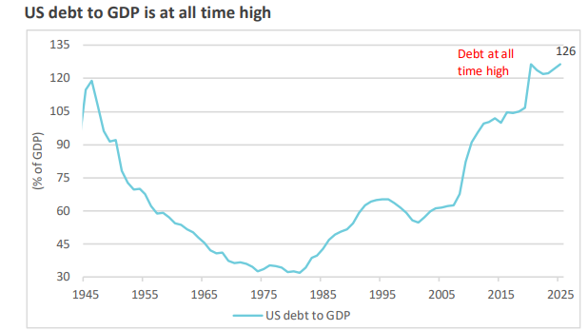
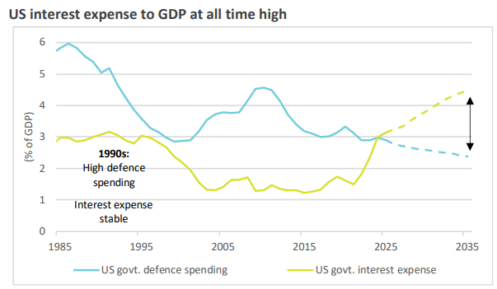
High US debt limits military spending ?
US debt & interest costs near record highs, limiting fiscal flexibility
Limited external funding restricts capacity for prolonged conflicts
Source: Nuvama Research
www.shriramamc.in

Slide 13
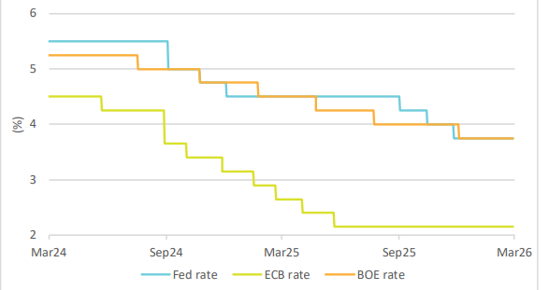
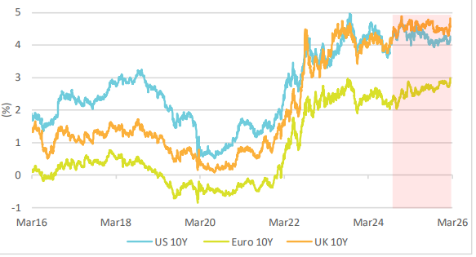
Global bond markets unlike past cycles
Global rate cuts
Yields remain elevated
G7 bonds volatile amid high debt and shrinking safe-haven demand
Yields stay elevated despite rate cuts, energy and inflation risks add pressure
Source: Nuvama Research
www.shriramamc.in

Slide 14
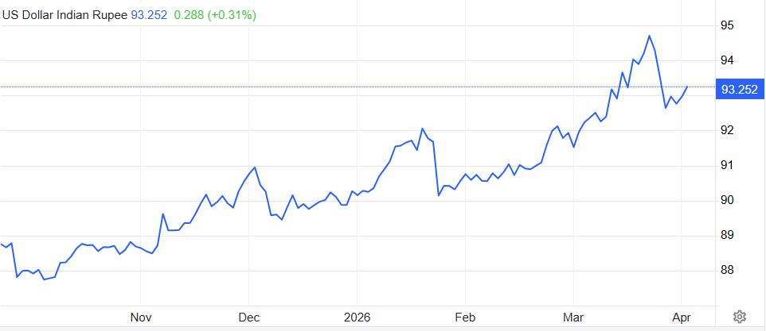
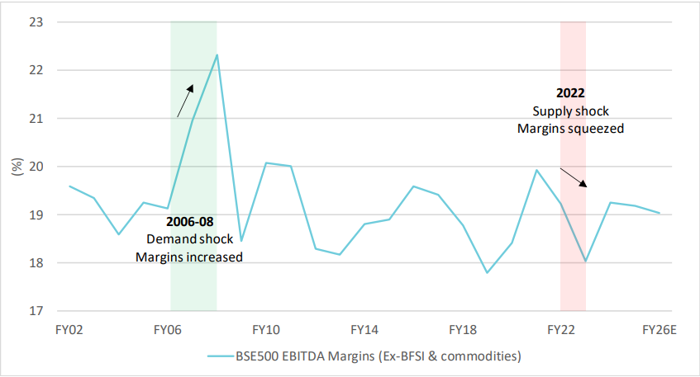
India more exposed to supply shocks
USD/INR price 6M data
BSE 500 EBITDA margins
INR briefly hit ~95 in Mar-26 before stabilizing on RBI support
Margins in Indian equities compress in supply-led oil shocks, while demand-led increases are better absorbed
Source: Nuvama research & Trading economics
INR data as on 7th April,2026
www.shriramamc.in

Slide 15
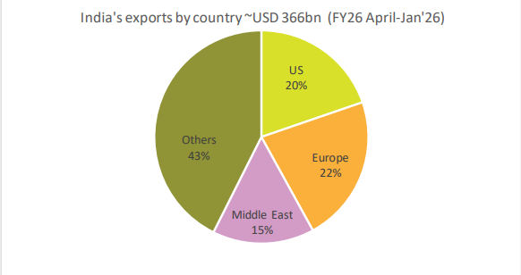
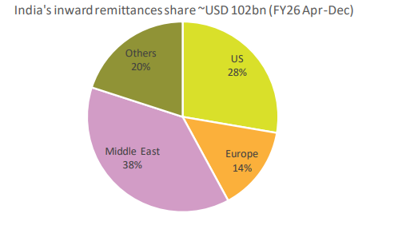
Middle East oil shock risks higher for India
Middle east contributes ~15% of exports & 38% of remittances, ~$100bn annual inflows
Source: Nuvamaesearch
www.shriramamc.in

Slide 16
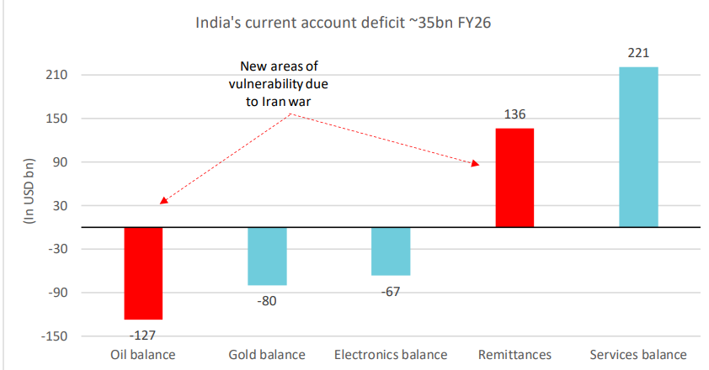
India’s CAD and BoP under pressure
War-driven risks to CAD and BoP through higher oil imports, softer remittances, and volatile capital flows
Source: Nuvama research
www.shriramamc.in

Slide 17
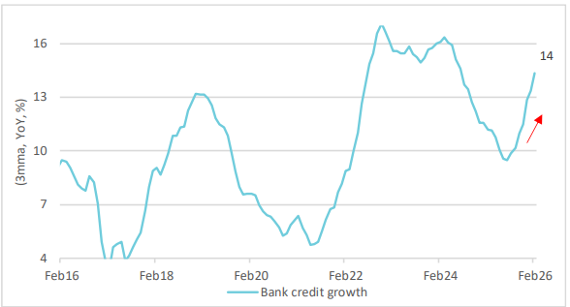
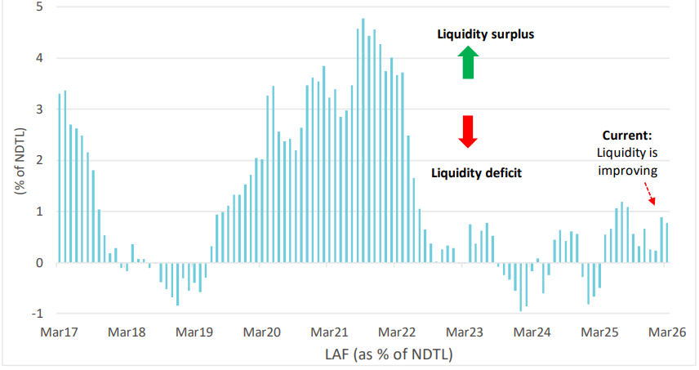
RBI liquidity management remains key
Bank Credit growth
RBI LAF as % of NDTL
RBI’s regulatory easing has revived credit growth
RBI’s liquidity support helps cushion growth despite outflows
Source: Nuvama Research
www.shriramamc.in

Slide 18
Sector Indices performance – Mar-26
Period | Nifty Auto | Nifty Bank | Nifty Consumer Durables | Nifty CPSE | Nifty FMCG | Nifty Pharma | Nifty IT | Nifty Metal | Nifty Oil & Gas | Nifty Realty | Nifty Energy | Nifty Commodities
1M | -16% | -15% | -12% | -3% | -11% | -3% | -5% | -9% | -12% | -17% | -6% | -8%
3M | -16% | -12% | -10% | 8% | -18% | -2% | -23% | 0% | -12% | -26% | -1% | -4%
6M | -10% | -4% | -11% | 7% | -17% | 4% | -14% | 11% | -4% | -25% | 0% | 2%
1Y | 12% | 1% | -7% | 12% | -15% | 5% | -21% | 23% | 2% | -24% | 4% | 8%
All sectors in red in 1M period
Data Source: NiftyIndices.com
Data as on 30th March,2026
Disclaimer: Past performance may or may not sustain in the future
www.shriramamc.in

Slide 19
Sectors update
Sectors | Key Developments | Valuation | Our View
Consumer Durables | RAC companies plan 8–10% price hikes amid rising commodity costs and BEE changes, with hotter summers this year likely to boost demand. West Asia LPG disruptions have also increased demand for induction cooktops and other electric appliances. Companies with higher inventories are positioned to benefit amid limited gas supply | Trailing P/BV at 5 yr average | Underweight
Oil & Gas | Sector remains geopolitically driven, with crude elevated (~$105/bbl) keeping volatility high, while global LNG markets stay tight despite softer US gas. ATF and diesel prices have risen with crude, and domestic LPG losses remain high (ATF ~₹64/litre; LPG ~₹380/cylinder) due to limited pass-through, keeping OMC margins under pressure | Trailing P/BV below 5-yr average | Stock Specific
Auto | March’26 retail data shows demand remains intact across 2Ws, PVs, CVs and tractors, growth has moderated from a high base, with EV penetration rising, led by 2Ws. Elevated crude and West Asia tensions are beginning to pressure input costs and logistics, posing risks to OEMs and exporters, with crude trajectory and supply chain disruptions key monitorable into FY27 | Trailing P/BV trading at 5-yr average | Stock specific
FMCG | West Asia tensions are likely to impact FMCG through higher crude-linked input costs (petroleum derivatives), along with pressures on packaging, freight and palm oil, making crude volatility a key margin risk for Q1 FY27 (with limited Q4 impact due to inventory buffers). Unseasonal rains across North and East India in March’26 have also dampened demand for summer categories | Trailing P/BV j below -1yr SD | Stock specific
Disclaimer: Sectors specific views mentioned herein are for Information purpose only, the Fund may or may not hold any present or future positions in these sectors
www.shriramamc.in

Slide 20
Sectors update
Sectors | Key Developments | Valuation | Our View
Banks | Bank credit growth remained strong at 14.6% YoY (15 Mar’26), outpacing deposits at 11.1%, with broad-based demand across industry, retail, and services (Feb’26). System liquidity stays in surplus (~₹1.3 tn), aided by RBI OMO/VRR. Regulatory changes and rising G-Sec yields may cause short-term MTM pressures, but credit momentum, stabilizing NIMs, and limited stressed exposure support a positive sector outlook | Trailing P/BV near –2 SD | Stock Specific
Metals | Steel HRC prices rose in March 2026 on strong demand, while higher coking coal and iron ore keep raw material costs elevated. Middle East disruptions have limited impact on integrated steel players but may strain secondary producers. Aluminum nears 4 years highs due to supply constraints and smelter shutdowns, with West Asia developments remaining key for non-ferrous price trends | Trailing P/BV ~ 5-yr >+2× SD | Stock specific
CPSE | Sector is supported by a strong multi-year defence capex cycle (~INR2.38 tn), driving modernization and localization across Army, Air Force, and Coast Guard platforms. The power sector faces a surge in electricity demand due to West Asia LPG disruptions, accelerating the shift to electric cooking and commercial use, stressing grids and thermal plants, while government measures aim to boost LPG production and PNG adoption | Trailing P/BV ~ 5-yr near +1× SD | Stock specific
Disclaimer: Sectors specific views mentioned herein are for Information purpose only, the Fund may or may not hold any present or future positions in these sectors
www.shriramamc.in

Slide 21
Sectors update
Sectors | Key Developments | ValuationFY25 | Our View
IT | Indian IT companies are leveraging AI partnerships to position themselves as transformation leaders. Despite a sharp valuation correction due to AI disruption fears, strong deal pipelines and steady demand support medium-term optimism. Near-term growth may be muted, with Tier-2 firms outperforming, benefiting from INR depreciation and stable margins amid ongoing uncertainties | Trailing P/BV below -2 SD | Stock Specific
Pharma | A major recent development in the Indian healthcare space has been the surge in generic launches of Semaglutide following the patent expiry of Novo Nordisk in March 2026. The entry of multiple domestic players at sharply lower price points is expected to significantly broaden access and expand the market opportunity. The imaging segment faces emerging headwinds due to geopolitical tensions, as disruptions in West Asia have constrained helium supply, which is an essential input for MRI operations | Trailing P/BV near +1 SD | Stock specific
Chemicals | India’s chemicals industry is projected to reach USD 230–255bn by 2030, driven by high-growth segments such as EVs, semiconductors, renewables, and aerospace. In 2026, the sector faces weak demand, inventory destocking, and global oversupply from China, putting pressure on margins and resulting in a bearish near-term outlook | Trailing P/BV fairly valued | Stock specific
Disclaimer: Sectors specific views mentioned herein are for Information purpose only, the Fund may or may not hold any present or future positions in these sectors
www.shriramamc.in

Slide 22
FIIs selling spikes in Mar-26
DIIs continued to offset heavy FII selling in March 2026
Source: Moneycontrol.com
FII data as on 25th Mar-26 &DII data as on 20th Mar-26
www.shriramamc.in

Slide 23
Global Update
www.shriramamc.in

Slide 24
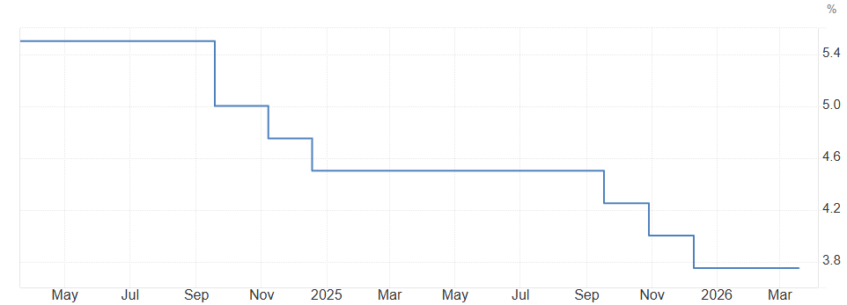
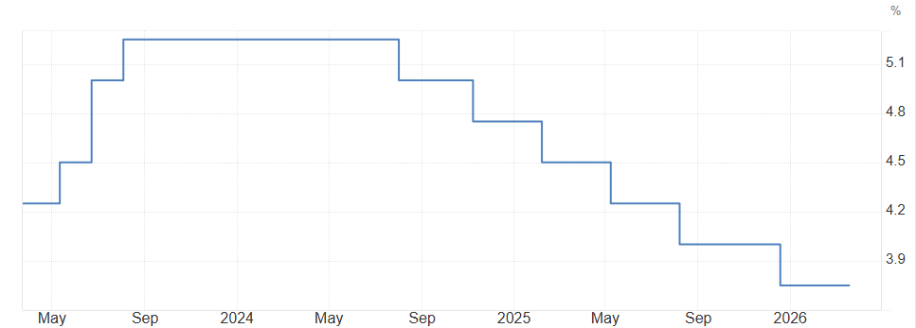
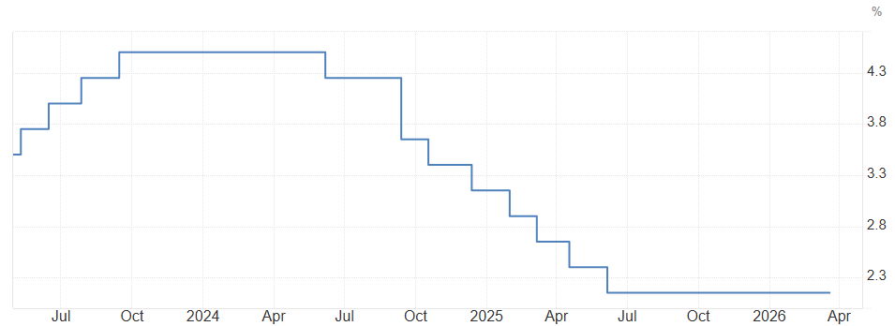
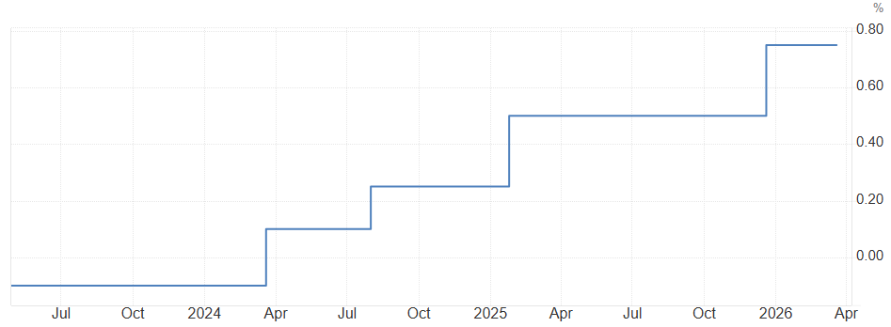
Global interest rate unchanged
U.S. (unchanged in Mar-26)
UK (unchanged in Mar-26)
EU (unchanged in Mar-26)
Japan (unchanged in Mar-26)
Source: Trading Economics
www.shriramamc.in

Slide 25
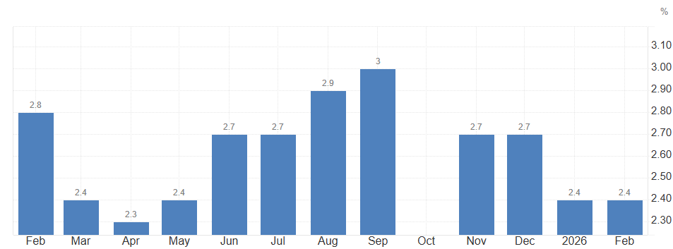
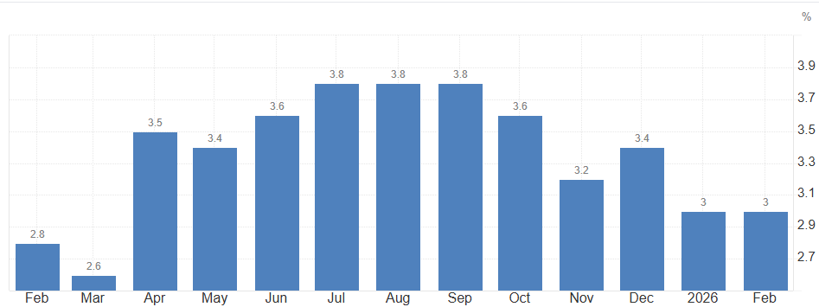
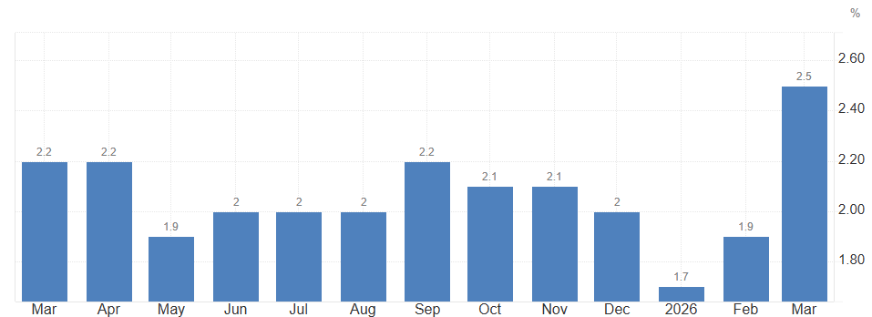
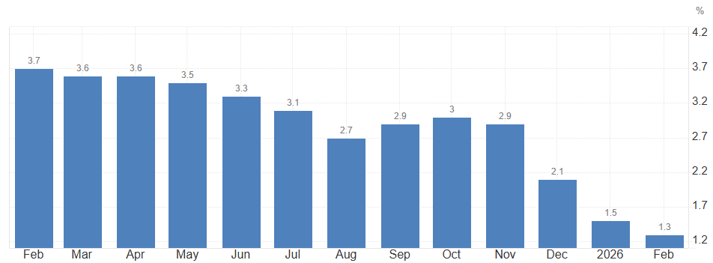
Global inflation trends remain mixed
U.S
UK
EU
Japan
Source: Trading Economics
www.shriramamc.in

Slide 26
Domestic Update
www.shriramamc.in

Slide 27
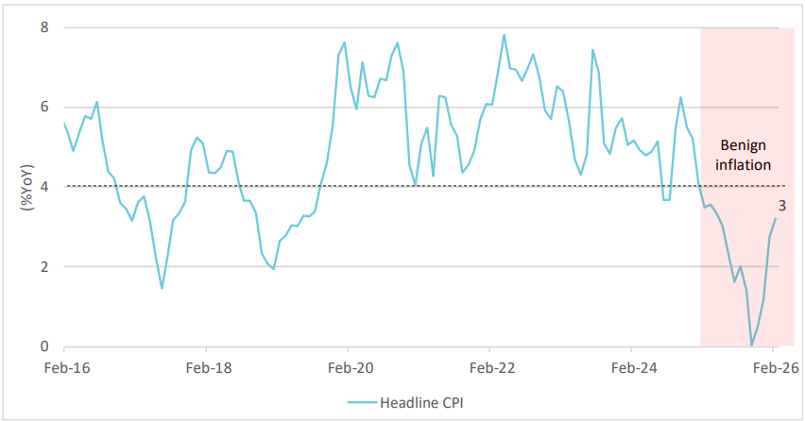
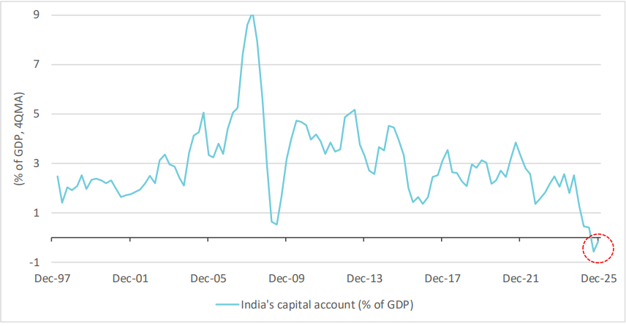
Macro updates
Headline CPI %
Capital account % of GDP
Inflation remain benign, with risks limited unless supply shocks broaden
Capital flows turn negative amid FII outflows and weak FDI, driven by high valuations
Source: Nuvama research CPI data as on Feb-26, Capital account data as on Dec-25
www.shriramamc.in

Slide 28
Robust GST collections in Mar-26
GST collections up 8.8% YoY to ~Rs 2 lakh crs in Mar-26, driven by steady demand
Source: Gst.gov.in
www.shriramamc.in

Slide 29
PMI : Manufacturing Strengthens
India’s Manufacturing PMI rose to 56.9 in Mar-26, back of slow factory output
India’s Services PMI remained steady at 57.2 in Mar-26, amid slower demand
Source: Trading Economics
Data as on Mar-26
www.shriramamc.in

Slide 30
Outlook – Medium Term
Liquidity
RBI injected liquidity via VRR and OMOs to offset tightness in Mar-26
Interest rate
RBI keeps interest rates unchanged in Apr-26, maintains neutral stance
Bond Markets
Equity Markets
India’s 10Y G-sec rose to ~7% in Mar-26, pressured by soaring crude prices, weaker INR
Domestic equities remain volatile amid high valuations and escalating Middle east tensions
Fed left interest rate unchanged in Mar-26, amid geopolitical risk
US 10Y note yield rose to ~4.5% in Mar-26, on sticky inflation and higher for longer interest rates ex
Global markets remain unsettled amid rising Middle East and global trade uncertainty
Liquidity to remain sufficient amid rupee volatility
Inflation
India’s CPI rose to 3.21% (Feb-26), with core inflation remaining elevated, signalling persistent price pressures
US headline CPI remains to 2.4% (Feb-26), led by cooling energy and goods prices
Source: Trading Economics, Investing.com, Money control, Federal reserve
www.shriramamc.in

Slide 31
Key Risks
Concerns remain as high FY27 earnings estimates coincide with stretched market valuations
INR depreciation amid higher oil prices and FII outflows, despite RBI intervention
Trump’s proposed 100% tariffs on pharma imports raise market risks
Energy crisis from conflict could hit the economy, creating both price and supply shocks
Q4FY26 earnings and forward commentary key for markets
www.shriramamc.in

Slide 32
Disclaimer
DISCLAIMER The views expressed herein are based on internal data, publicly available information and other sources believed to be reliable. Any calculations made are approximations, meant as guidelines only, which you must confirm before relying on them. This document has been prepared based on information, which is already available in publicly accessible media or developed through analysis of Shriram Mutual Fund. The recipient should note and understand that the information provided above may not contain all the material aspects relevant for making an investment decision and the security may or may not continue to form part of the scheme's portfolio in the future. Investors are advised to consult their investment advisor before making any investment decision in light of their risk appetite, investment goals, and horizon. The decision of the Investment Manager may not always be profitable; as such decisions are based on the prevailing market conditions and the understanding of the Investment Manager. Actual market movements may vary from the anticipated trends. Past performance may or may not be sustained in future. Sectors referred above are illustrative and not recommended by Shriram Mutual Fund (the Fund) / Shriram AMC. The Fund may or may not have any present or future positions in these sectors. Shriram AMC / the Fund is not guaranteeing / offering / communicating any indicative yield on investments made in the scheme(s). Neither Shriram AMC and the Fund nor any person connected with them, accepts any liability arising from the use of this document. The recipient(s) before acting on any information herein should make his/her/their own investigation and seek appropriate professional advice and shall alone be fully responsible / liable for any decision taken on the basis of information contained herein. Please refer to the Offer Documents/ Statement of Additional Information/ Key Information Memorandum of the Scheme before investing.
MUTUAL FUND INVESTMENTS ARE SUBJECT TO MARKET RISKS, READ ALL SCHEME RELATED DOCUMENTS CAREFULLY.
www.shriramamc.in

Slide 33
Thank You

